Slide 1
Consumer resource model for prediction of abundance dynamics

Slide 2
Clustering metabolite consumption matrix using inferred metabolite abundances
Top 4 metabolite clusters
Metabolites in cluster | Inferred abundance
'FRUCTOSE 6-PHOSPHATE', '5-AMINOPENTANOIC ACID', 'BENZALDEHYDE', 'MALEAMIC ACID', '3-DEHYDROSHIKIMIC ACID', 'METHYL BETA-GALACTOSIDE', 'ACETYLCHOLINE', 'DEOXYURIDINE' | 0.3505
CINNAMALDEHYDE | 0.156
'GALACTOSAMINE', 'PIPECOLIC ACID', 'CROTONIC ACID', '3-FUROIC ACID', '2-METHYLBUTYRYLGLYCINE', '3-METHOXYTYRAMINE', "CYTIDINE 5'-DIPHOSPHOCHOLINE", '2,6-DIAMINOHEPTANEDIOIC ACID', 'N-ACETYLTRYPTOPHAN', 'PHENYLACETYLGLYCINE', 'PYRIDOXINE', 'SN-GLYCERO-3-PHOSPHOCHOLINE' | 0.0812
3'-CMP | 0.0598
#metabolites = 292
#clusters = 76
In the heatmap, clusters arranged in decreasing order of inferred metabolite abundances
Metabolites clustered by first embedding metabolite consumption matrix using UMAP, and then clustering in the embedding space using HDBSCAN (Hierarchical Density-Based Spatial Clustering of Applications with Noise)

Slide 3
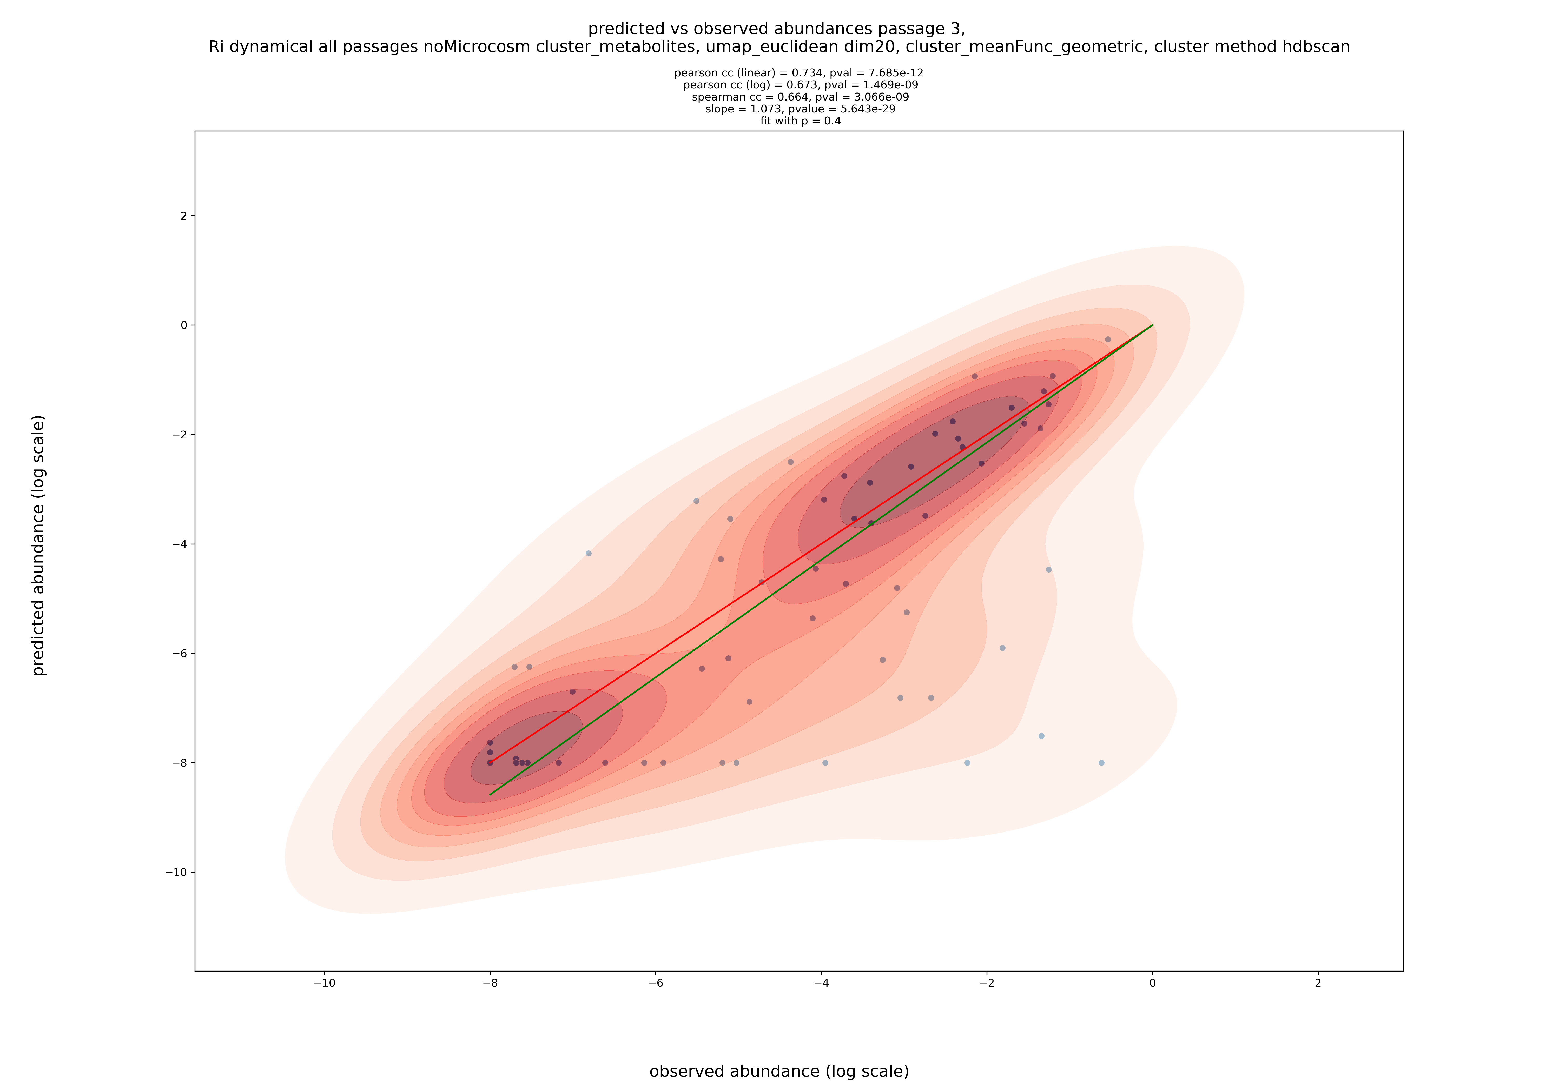
Predicted vs observed bacterial strain abundances at passage 3
Blindly predict abundance starting with inoculum abundances
Using inferred metabolite abundances
Using a dynamical model
Assuming that metabolite distribution among strains is decided by strain abundances at a fraction (f (1 – p)) of 0.6 between successive passages

Slide 4
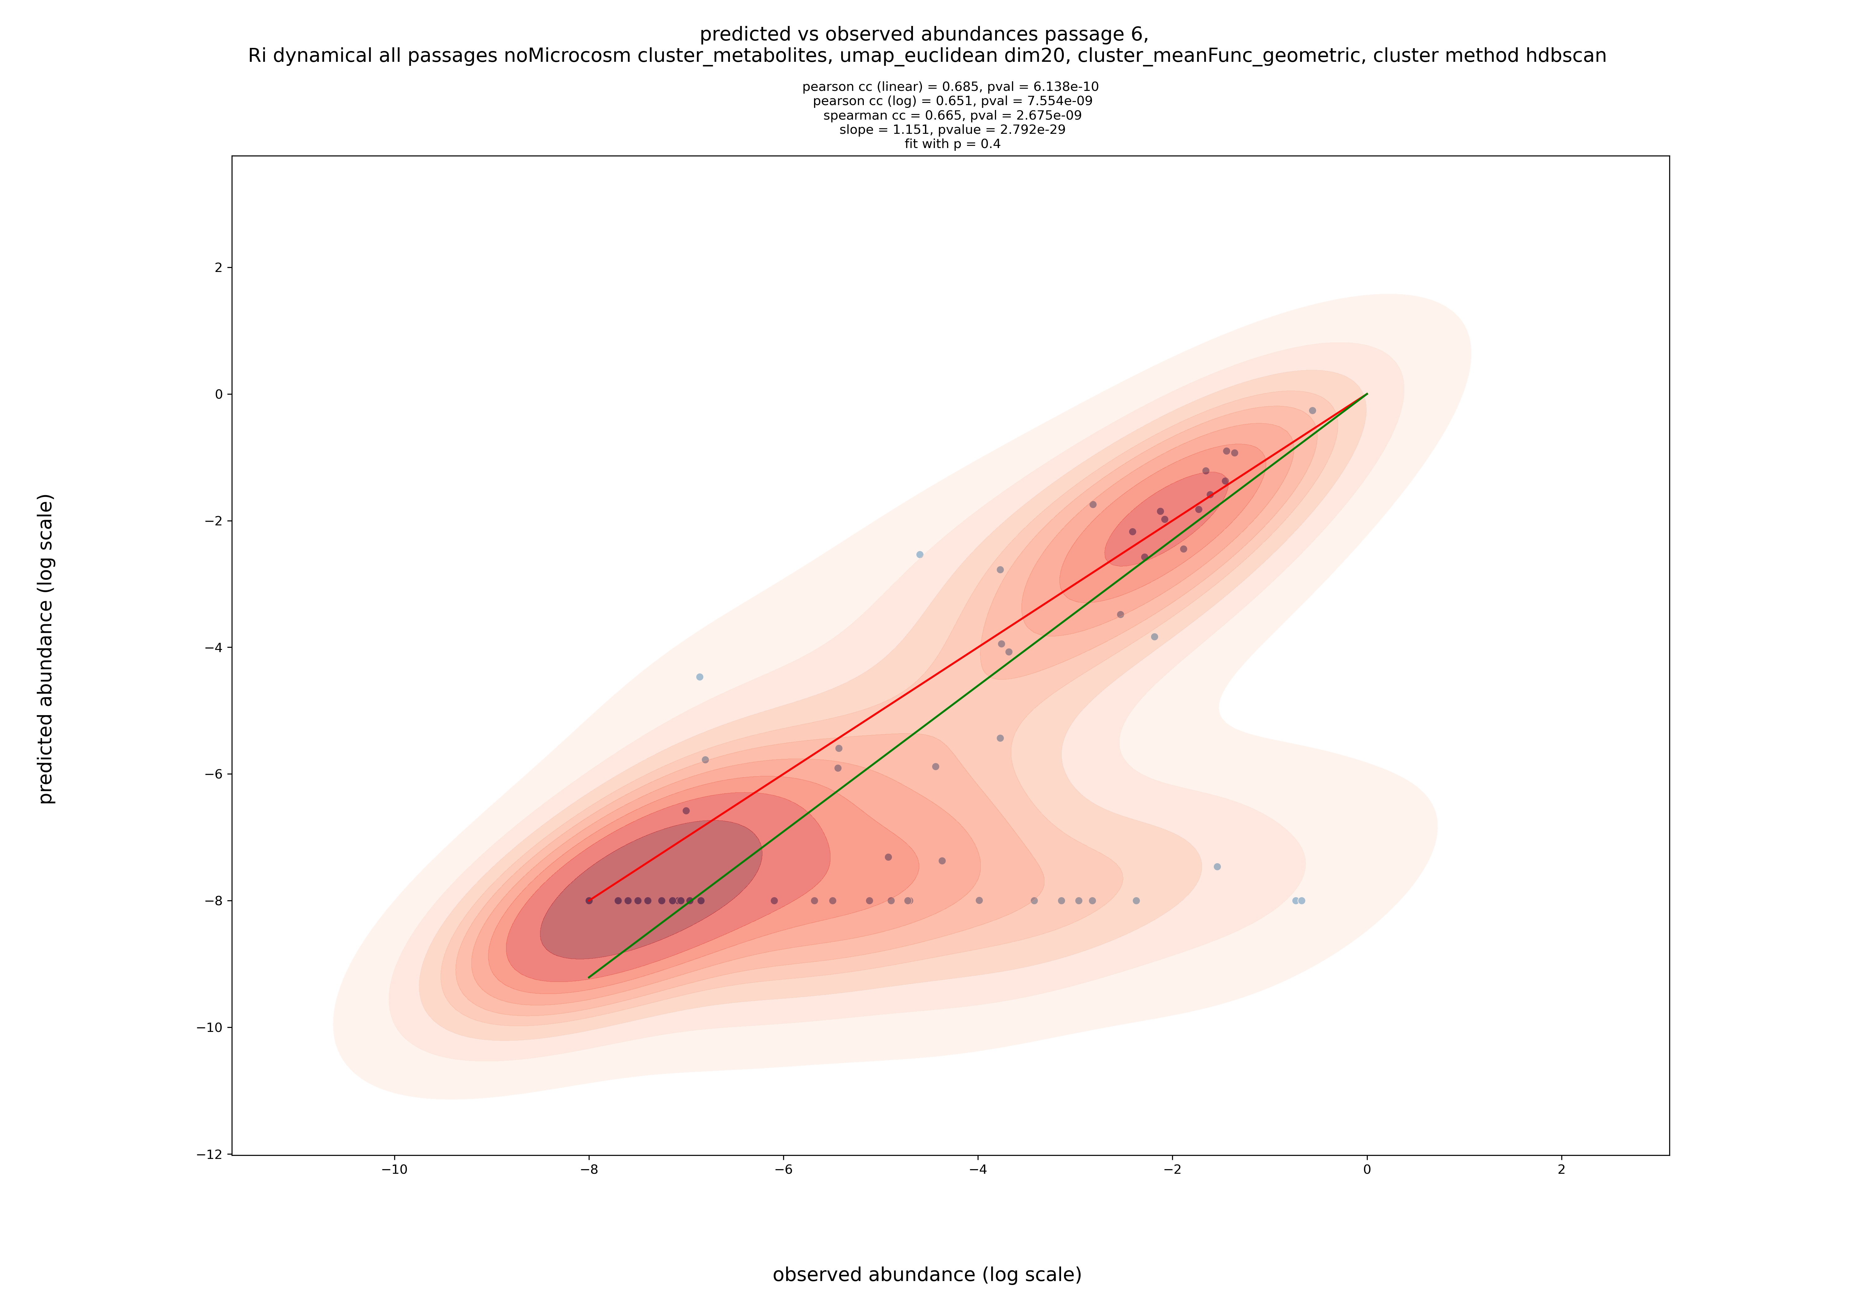
Predicted vs observed bacterial strain abundances at passage 6
Blindly predict abundance starting with inoculum abundances
Using inferred metabolite abundances
Using a dynamical model
Assuming that metabolite distribution among strains is decided by strain abundances at a fraction (f (1 – p)) of 0.6 between successive passages

Slide 5
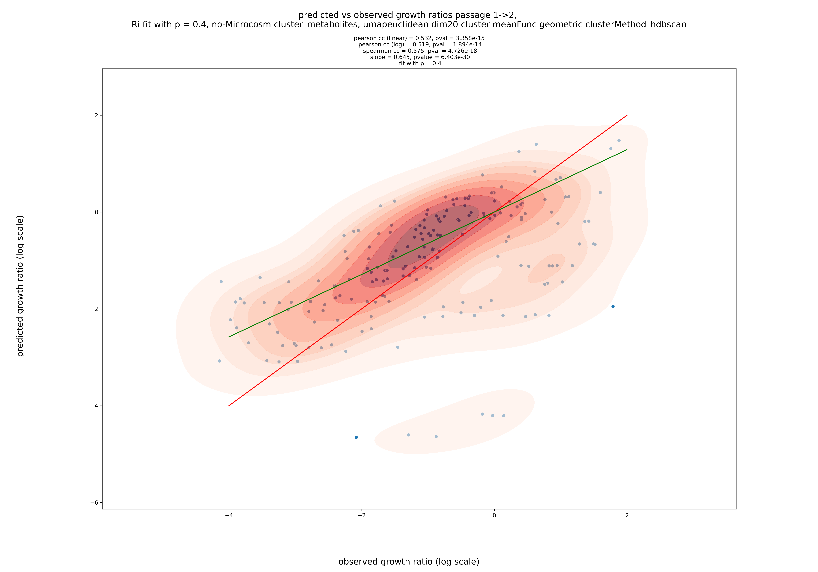
Predicted vs observed abundance growth ratio while transitioning from passage 1 to 2
Starting with strain abundances at passage 1, predict growth ratio for transition to passage 2
Using inferred metabolite abundances
Using a dynamical model
Assuming that metabolite distribution among strains is decided by strain abundances at a fraction (f (1 – p)) of 0.6 between successive passages

Slide 6
Model prediction without clustering metabolites

Slide 7
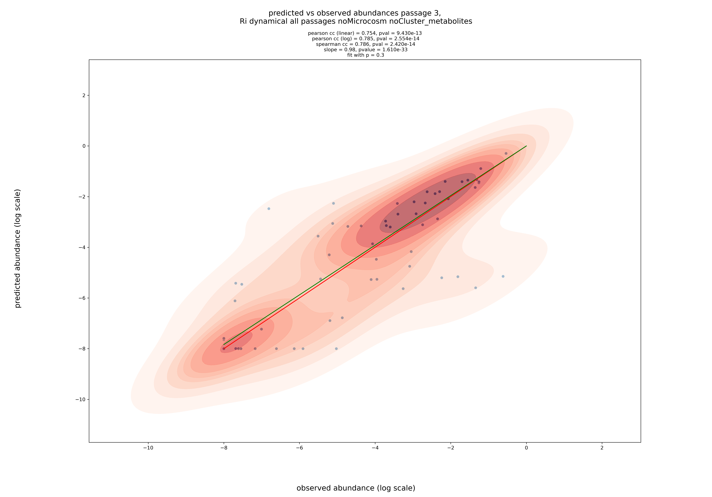
Predicted vs observed bacterial strain abundances at passage 3
Blindly predict abundance starting with inoculum abundances
Using inferred metabolite abundances
Using a dynamical model
Assuming that metabolite distribution among strains is decided by strain abundances at a fraction (f (1 – p)) of 0.7 between successive passages

Slide 8
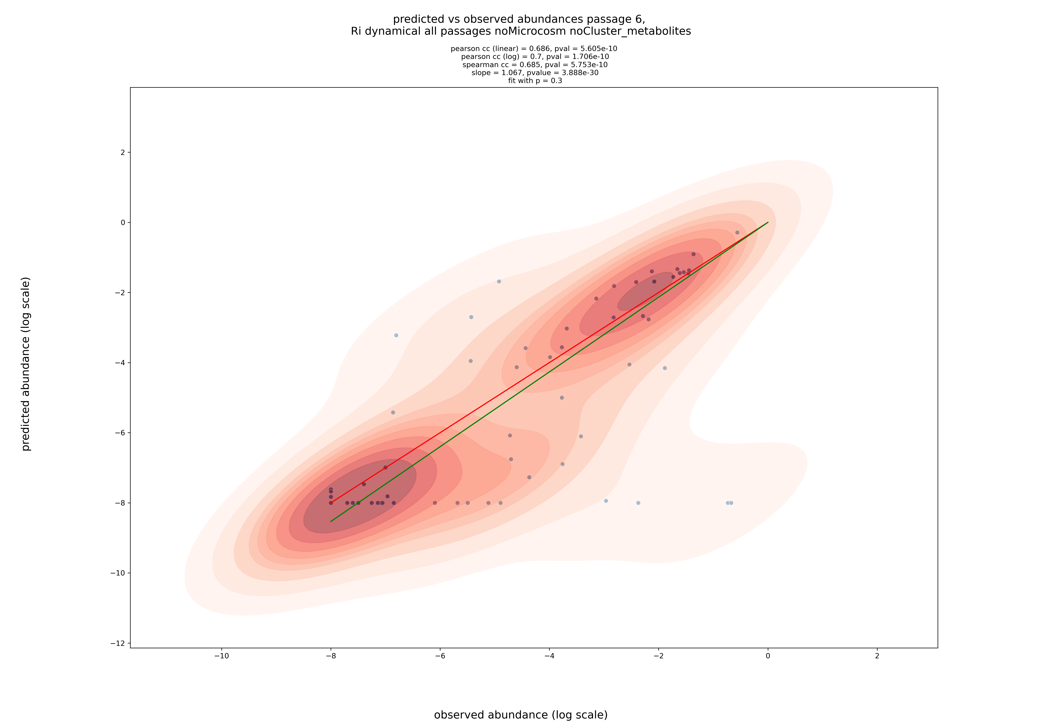
Predicted vs observed bacterial strain abundances at passage 6
Blindly predict abundance starting with inoculum abundances
Using inferred metabolite abundances
Using a dynamical model
Assuming that metabolite distribution among strains is decided by strain abundances at a fraction (f (1 – p)) of 0.7 between successive passages

Slide 9
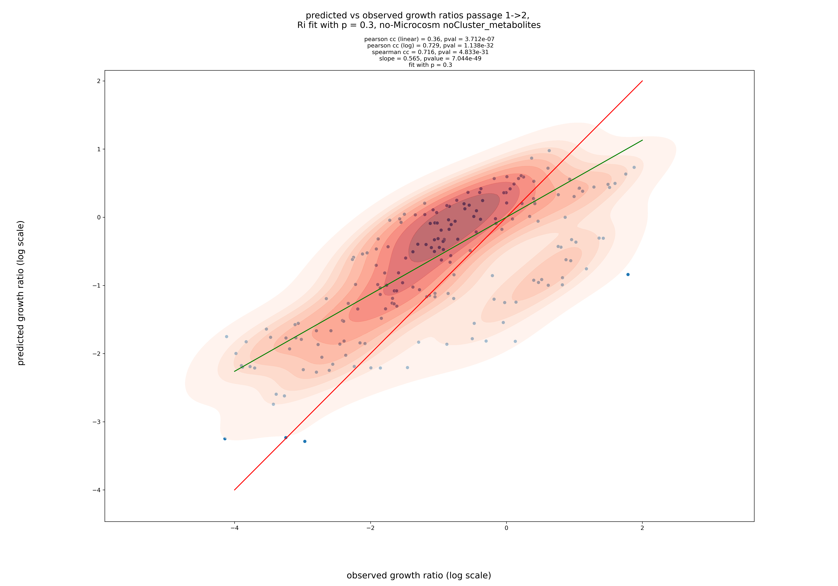
Predicted vs observed abundance growth ratio while transitioning from passage 1 to 2
Starting with strain abundances at passage 1, predict growth ratio for transition to passage 2
Using inferred metabolite abundances
Using a dynamical model
Assuming that metabolite distribution among strains is decided by strain abundances at a fraction (f (1 – p)) of 0.7 between successive passages

